Slide 1
Big Mountain Resort
Pricing Model
Data Science Team - Camilo Durango

Slide 2
Problem Identification
Big Mountain Resort has recently invested in a new chair lift to help distribute visitors across the mountain. Therefore, it’s made an investment that has brought up additional operational costs ($1,540,000). However, its current pricing strategy is inefficient as it does not reflect the quality of its facilities. A standard ticket priced just above market average will not promote the revenue increase Big Mountain’s executives are looking for.
Proposed Analysis:
By creating a pricing benchmark of the ski resorts market, the data science team will be able to evaluate relevant features that drive the price and their relationship. Then, we will build a predictive model taking into account relevant insights from the data to come up with a price that will reflect Big Mountain facilities before the season starts.

Slide 3
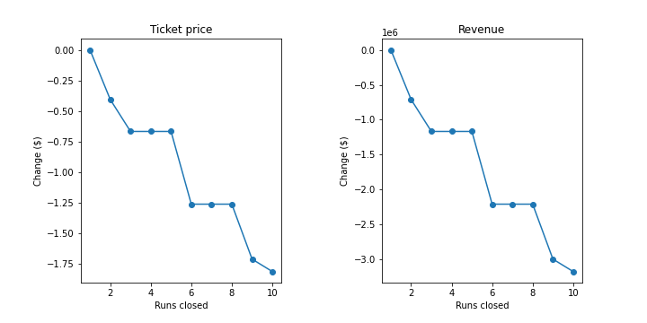
Recommendations & Key Findings
We recommend choosing scenario 2. It will $1.99 increase in ticket price will result in a revenue increase of $3,474,638 on the basis of each visitor buying 5 tickets on average.
Through the process, we found out the correlation between number of runs and price is strong. Therefore, we recommend avoiding closing runs as a strategy.

Slide 4

Modeling & Analysis
We arrived to the recommendation mentioned before working through a series of steps:
Data Wrangling
Exploratory Data Analysis
Preprocessing & Training
Modeling
Notes:
<a href="https://www.flaticon.com/free-icons/data-science" title="data science icons">Data science icons created by Dighital Design - Flaticon</a>

Slide 5
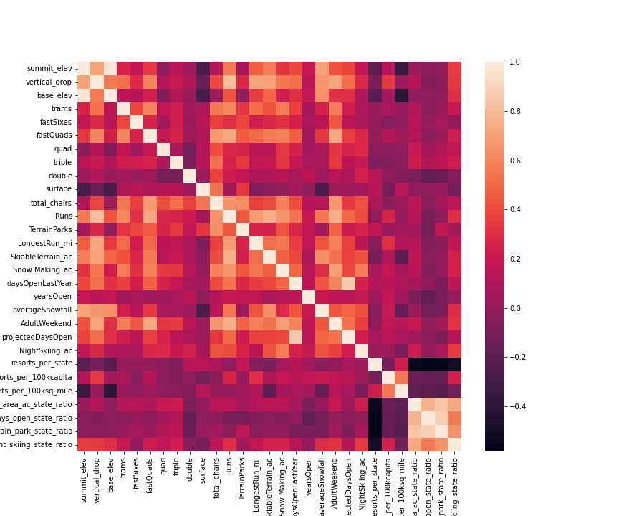
Data Wrangling & EDA
In the first step, we cleaned and organized the raw data into readable and interpretable dataset.
We identified potential corrections in the data and reduced its dimensionality to perform further analysis.
Evaluated the categorical and numerical statewide data by visualizing features correlations to introduce them to the model.

Slide 6
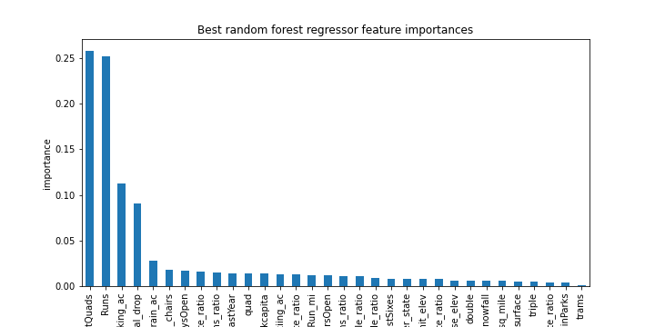
Preprocessing & Training
We performed a train/test split to prevent creating a biased models optimising them and choosing Random Forest Regression as the best fit to solve the problem.
We identified high correlations with the target variable (ticket price) in FastQuads, Runs, Snow Making_ac and Vertical_Drop.
Finally, we validate the model using cross-validation strategy.

Slide 7
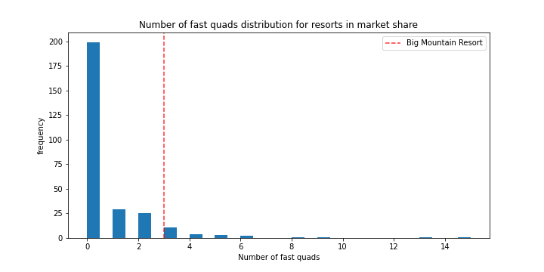
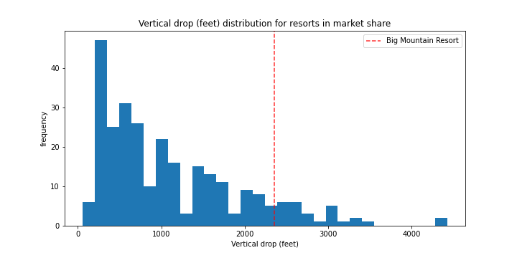
Conclusion
Big Mountain Resort has high quality facilities ranking on the top among its competitors but the pricing strategy is not reflecting these.
Through model optimisation, we picked and cross-validate a Random Forest Regression model that is suitable to restructure ticket pricing; thus increasing revenue.
The ML model can and should be utilize by the resort business analyst to adjust and explore more scenarios.

